Slide 1
Cat 3: Behavioral Patterns
Iterator Pattern
Pattern that are most specifically concerned with communication between objects
Slide

Slide 2
class Module:
def __init__(self, list):
self.__list = list
def addStudent(self, name):
self.__list.append(name)
def main():
list = ["J.Smith", "T.Ryan", "L.Shine", "p.Whyte"]
m=Module(list)
newStudent = input('Enter Name:')
m.addStudent(newStudent)
main()
Given Following Class
Slide

Slide 3
class Module:
def __init__(self, list):
self.__list = list
def addStudent(self, name):
self.__list.append(name)
def main():
list = ["J.Smith", "T.Ryan", "L.Shine", "p.Whyte"]
m=Module(list)
newStudent = input('Enter Name:')
m.addStudent(newStudent)
printList(list)
def printList(list):
Iterator value = m.getIterator();
while value.hasNext():
print(" :"+value.next())
Iterator
Slide

Slide 4
from abc import abstractmethod, ABC
class Iterator(ABC):
@abstractmethod
def hasNext(self) -> bool:
pass
@abstractmethod
def next(self) -> object:
pass
class Container(ABC):
@abstractmethod
def getIterator(self) -> Iterator:
pass
Need to make
Module Iterateable
Slide

Slide 5
class Module (Container,Iterator):
def __init__(self, list):
self.__list = list
self.__index=0
def getIterator(self):
return Module(self.__list)
def hasNext(self):
return self.__index<len(self.__list)
def next(self):
res=self.__list[self.__index]
self.__index += 1
return res
def addStudent(self, name):
self.__list.append(name)
Slide

Slide 6
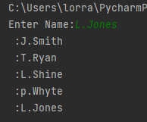
Iterator
def main():
list = ["J.Smith", "T.Ryan", "L.Shine", "p.Whyte"]
m=Module(list)
newStudent = input('Enter Name:')
m.addStudent(newStudent)
printList(list)
def printList(list):
Iterator value = m.getIterator();
while value.hasNext():
print(" :"+value.next())
Slide

Slide 7
class Student:
def __init__(self, name,m1,m2,m3,m4):
self.__name = name
self.__mark1 = m1
self.__mark2 = m2
self.__mark3 = m3
self.__mark4 = m4
self.__index=0
def toList(self):
return [self.__mark1, self.__mark2, self.__mark3, self.__mark4 ]
def printDetails(self):
print('\nStudent Details:')
print('-----------------')
print('Name= ', self.__name)
print('Marks= ', self.__mark1,self.__mark2, self.__mark3,
self.__mark4)
Q361
Introduce an
Interator
Slide

Slide 8
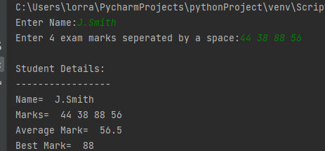
def getAverageMark(s):
value = s.getIterator();
total=0
while value.hasNext():
mark =value.next()
total += mark
return total/4
Q361
Expected Output
Slide

Slide 9
class Number:
def __init__(self, number):
self.__number = number
self.__index=0
def toString(self):
return str(self.__number)
def printDetails(self):
print('\nStudent Details:')
print('-----------------')
print('Number= ', self.__number)
Q362
Introduce an
Interator
Slide

Slide 10
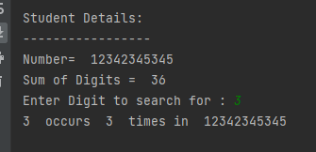
def getSumDigits(n):
value = n.getIterator();
total=0
while value.hasNext():
digit =value.next()
total += digit
return total
Q362
Expected Output
Slide

Slide 11
class Sentence :
def __init__(self, sentence):
self.__sentence = sentence
self.__index=0
def toList(self):
result = self.__sentence.split()
return result
def printDetails(self):
print('\nStudent Details:')
print('-----------------')
print('Number= ', self.__sentence)
Q363
Introduce an
Interator
Slide

Slide 12
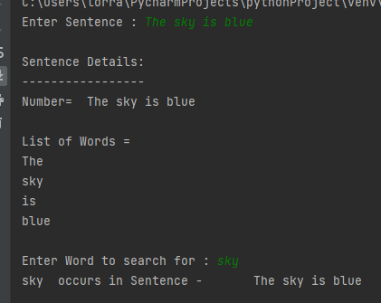
Q363
Expected Output
def printWords(n):
value = n.getIterator();
while value.hasNext():
word=value.next()
print(word)
Slide

